Slide 1
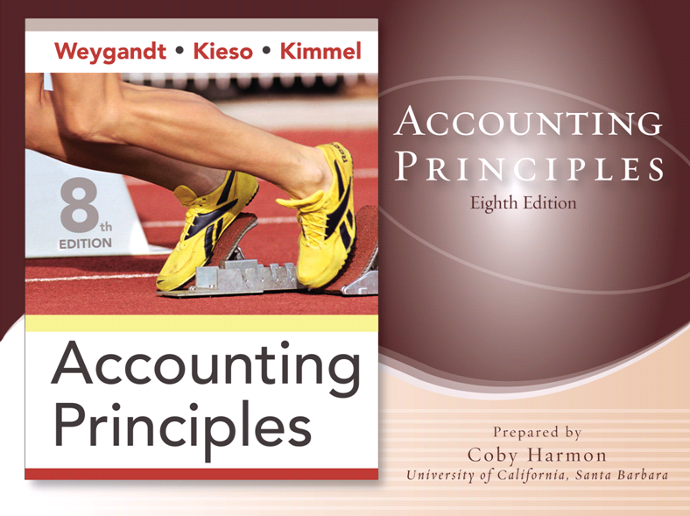

Slide 2
CHAPTER 10
PLANT ASSETS, NATURAL RESOURCES, AND INTANGIBLE ASSETS
Accounting Principles, Eighth Edition

Slide 3
Study Objectives
Describe how the cost principle applies to plant assets.
Explain the concept of depreciation.
Compute periodic depreciation using different methods.
Describe the procedure for revising periodic depreciation.
Distinguish between revenue and capital expenditures, and explain the entries for each.
Explain how to account for the disposal of a plant asset.
Compute periodic depletion of natural resources.
Explain the basic issues related to accounting for intangible assets.
Indicate how plant assets, natural resources, and intangible assets are reported.
Notes:
1. On the topic, “Challenges Facing Financial Accounting,” what did the AICPA Special Committee on Financial Reporting suggest should be included in future financial statements?
Non-financial Measurements (customer satisfaction indexes, backlog information, and reject rates on goods purchases).
Forward-looking Information
Soft Assets (a company’s know-how, market dominance, marketing setup, well-trained employees, and brand image).
Timeliness (no real time financial information)

Slide 4

Plant Assets, Natural Resources, and Intangible Assets
Plant Assets
Natural Resources
Intangible Assets
Statement Presentation and Analysis
Determining the cost of plant assets
Depreciation
Expenditures during useful life
Plant asset disposals
Depletion
Accounting for intangibles
Research and development costs
Presentation
Analysis
Notes:
Service Cost - Actuaries compute service cost as the present value of the new benefits earned by employees during the year. Future salary levels considered in calculation.
Interest on Liability - Interest accrues each year on the PBO just as it does on any discounted debt.
Actual Return on Plan Assets - Increase in pension funds from interest, dividends, and realized and unrealized changes in the fair market value of the plan assets.
Amortization of Unrecognized Prior Service Cost - The cost of providing retroactive benefits is allocated to pension expense in the future, specifically to the remaining service-years of the affected employees.
Gain or Loss - Volatility in pension expense can be caused by sudden and large changes in the market value of plan assets and by changes in the projected benefit obligation. Two items comprise the gain or loss:
difference between the actual return and the expected return on plan assets and,
amortization of the unrecognized net gain or loss from previous periods

Slide 5

Section 1 – Plant Assets
Plant assets include land, land improvements, buildings, and equipment (machinery, furniture, tools).
Major characteristics include:
“Used in operations” and not for resale.
Long-term in nature and usually depreciated.
Possess physical substance.
Referred to as property, plant, and equipment; plant and equipment; and fixed assets.

Slide 6
Determining the Cost of Plant Assets
Land
Includes all costs to acquire land and ready it for use.
Costs typically include:
the purchase price;
closing costs, such as title and attorney’s fees;
real estate brokers’ commissions;
costs of grading, filling, draining, and clearing;
assumption of any liens, mortgages, or encumbrances on the property.
LO 1 Describe how the cost principle applies to plant assets.

Slide 7
Determining the Cost of Plant Assets
Land Improvements
Includes all expenditures necessary to make the improvements ready for their intended use.
Examples are driveways, parking lots, fences, landscaping, and underground sprinklers.
Limited useful lives.
Expense (depreciate) the cost of land improvements over their useful lives.
LO 1 Describe how the cost principle applies to plant assets.

Slide 8
Determining the Cost of Plant Assets
Buildings
Includes all costs related directly to purchase or construction.
Purchase costs:
Purchase price, closing costs (attorney’s fees, title insurance, etc.) and real estate broker’s commission.
Remodeling and replacing or repairing the roof, floors, electrical wiring, and plumbing.
Construction costs:
Contract price plus payments for architects’ fees, building permits, and excavation costs.
LO 1 Describe how the cost principle applies to plant assets.

Slide 9
Determining the Cost of Plant Assets
E10-3 On March 1, 2008, Penner Company acquired real estate on which it planned to construct a small office building. The company paid $80,000 in cash. An old warehouse on the property was razed at a cost of $8,600; the salvaged materials were sold for $1,700. Additional expenditures before construction began included $1,100 attorney’s fee for work concerning the land purchase, $5,000 real estate broker’s fee, $7,800 architect’s fee, and $14,000 to put in driveways and a parking lot.
Instructions
Determine amount to be reported as the cost of the land. For each cost not used, indicate the account debited.
LO 1 Describe how the cost principle applies to plant assets.

Slide 10
Determining the Cost of Plant Assets
E10-3 Determine amount to be reported as the cost of the land.
Land
Company paid $80,000 in cash.
$80,000
Old warehouse razed at a cost of $8,600
8,600
Salvaged materials were sold for $1,700.
- 1,700
Expenditures before construction began:
$1,100 attorney’s fee for work on land purchase.
1,100
$5,000 real estate broker’s fee.
5,000
$7,800 architect’s fee.
Building
0
$14,000 for driveways and parking lot.
0
Land Improvements
Total
$93,000
LO 1 Describe how the cost principle applies to plant assets.

Slide 11
Determining the Cost of Plant Assets
Equipment
Include all costs incurred in acquiring the equipment and preparing it for use.
Costs typically include:
purchase price,
sales taxes,
freight and handling charges,
insurance on the equipment while in transit,
assembling and installation costs, and
costs of conducting trial runs.
LO 1 Describe how the cost principle applies to plant assets.

Slide 12
Depreciation
Depreciation is the process of allocating the cost of tangible assets to expense in a systematic and rational manner to those periods expected to benefit from the use of the asset.
Process of cost allocation, not asset valuation.
Applies to land improvements, buildings, and equipment, not land.
Depreciable, because the revenue-producing ability of asset will decline over the asset’s useful life.
LO 2 Explain the concept of depreciation.

Slide 13
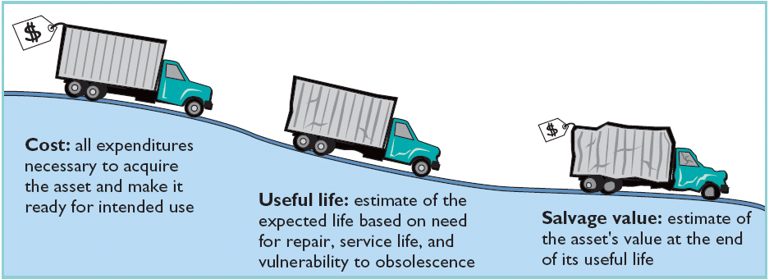
Depreciation
Factors in Computing Depreciation
Illustration 10-6
Cost
Useful Life
Salvage Value
LO 2 Explain the concept of depreciation.

Slide 14
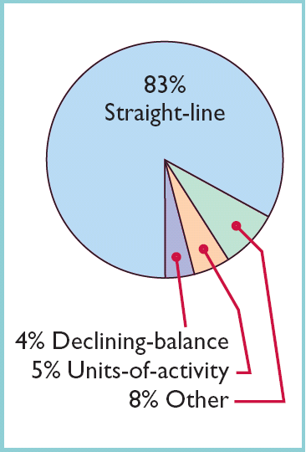
Depreciation
Depreciation Methods
Objective is to select the method that best measures an asset’s contribution to revenue over its useful life. Examples include:
Straight-line method.
Units-of-Activity method.
Declining-balance method.
Illustration 10-8 Use of depreciation methods in 600 large U.S. companies
LO 3 Compute periodic depreciation using different methods.

Slide 15
Depreciation
Exercise (Depreciation Computations—Three Methods)
Parish Corporation purchased a new machine for its assembly process on January 2, 2008. The cost of this machine was $117,900. The company estimated that the machine would have a salvage value of $12,900 at the end of its service life. Its life is estimated at 5 years and its working hours are estimated at 1,000 hours. Year-end is December 31.
Instructions: Compute the depreciation expense under the following methods.
(a) Straight-Line.
(b) Units-of-Activity.
(c) Declining Balance.
LO 3 Compute periodic depreciation using different methods.

Slide 16
Depreciation
Straight-Line
Expense is same amount for each year.
Depreciable cost is cost of the asset less its salvage value.
Straight-line method predominates in practice.
LO 3 Compute periodic depreciation using different methods.

Slide 17
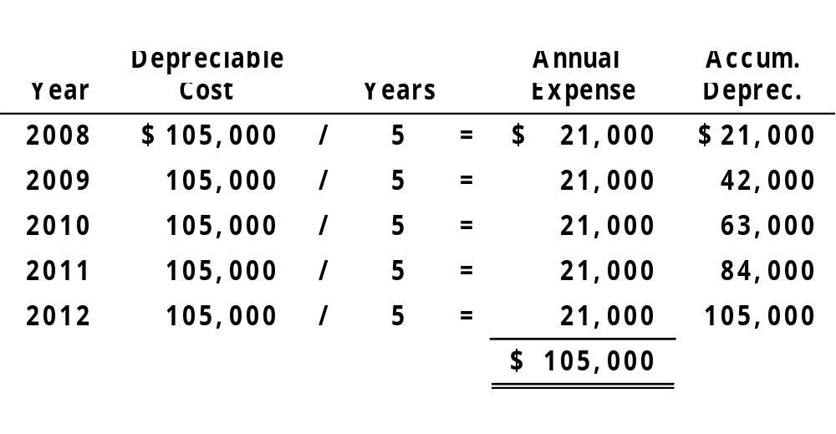
Depreciation
Exercise (Straight-Line Method)
2008 Journal Entry
Depreciation expense 21,000
Accumulated depreciation 21,000
LO 3 Compute periodic depreciation using different methods.

Slide 18
Depreciation
Units-of-Activity
Expense varies based on units of activity.
Depreciable cost is cost less salvage value.
Companies estimate total units of activity to calculate depreciation cost per unit.
LO 3 Compute periodic depreciation using different methods.

Slide 19
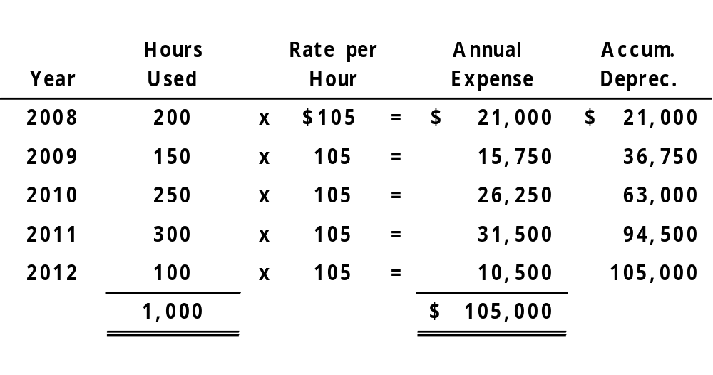
Depreciation
Exercise (Units-of-Activity Method)
($105,000 / 1,000 hours = $105 per hour)
2008 Journal Entry
Depreciation expense 21,000
Accumulated depreciation 21,000
LO 3 Compute periodic depreciation using different methods.

Slide 20
Depreciation
Declining-Balance
Decreasing annual depreciation expense over the asset’s useful life.
Declining-balance rate is double the straight-line rate.
Rate applied to book value (cost less accumulated depreciation.
LO 3 Compute periodic depreciation using different methods.

Slide 21
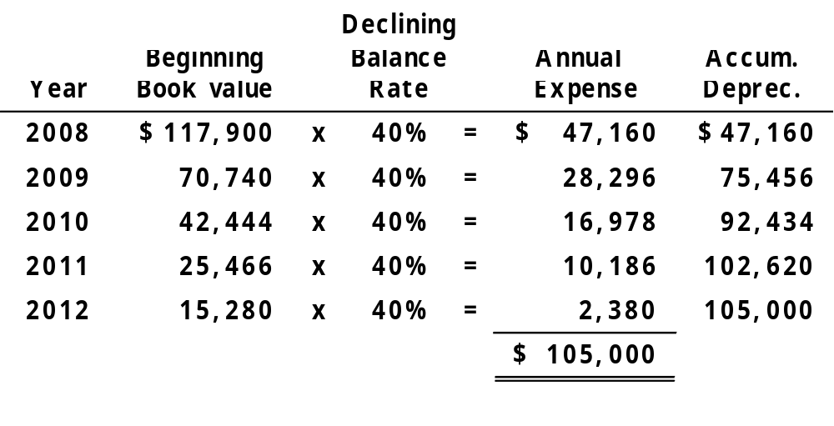
Depreciation
Exercise (Declining-Balance Method)
Plug
Depreciation expense 47,160
Accumulated depreciation 47,160
2008 Journal Entry
LO 3 Compute periodic depreciation using different methods.

Slide 22
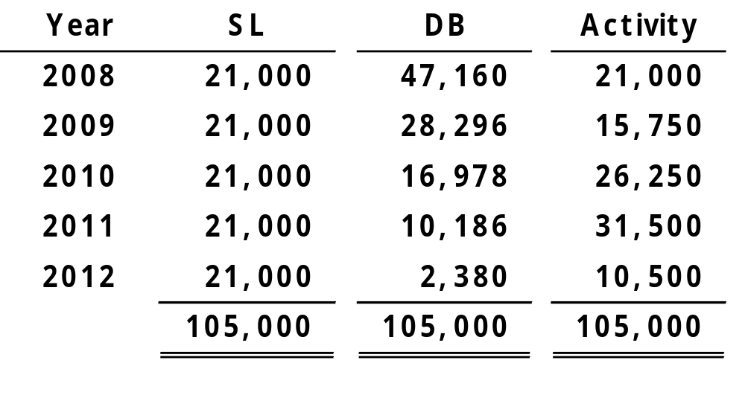
Depreciation
Comparison of Depreciation Methods
Comparison of Depreciation Methods
LO 3 Compute periodic depreciation using different methods.

Slide 23
Depreciation for Partial Year
The following additional slides are included to illustrate the calculation of partial-year depreciation expense.
The amounts are consistent with the previous slides illustrating the calculation of depreciation expense.
LO 3 Compute periodic depreciation using different methods.

Slide 24
Depreciation for Partial Year
Exercise (Depreciation Computations—Three Methods)
Parish Corporation purchased a new machine for its assembly process on October 1, 2008. The cost of this machine was $117,900. The company estimated that the machine would have a salvage value of $12,900 at the end of its service life. Its life is estimated at 5 years and its working hours are estimated at 1,000 hours. During 2008, the machine was used 30 hours. Year-end is December 31.
Instructions: Compute the depreciation expense under the following methods.
(a) Straight-Line.
(b) Units-of-Activity.
(c) Declining-Balance.
LO 3 Compute periodic depreciation using different methods.

Slide 25
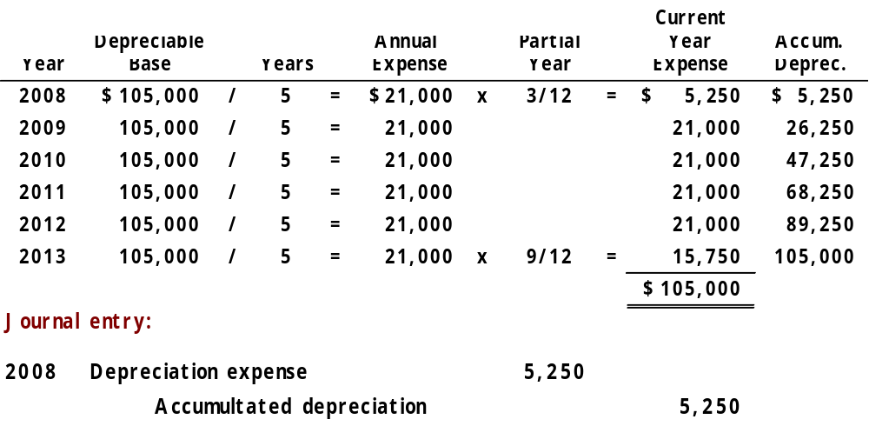
Depreciation for Partial Year
Exercise (Straight-line Method)
LO 3 Compute periodic depreciation using different methods.

Slide 26
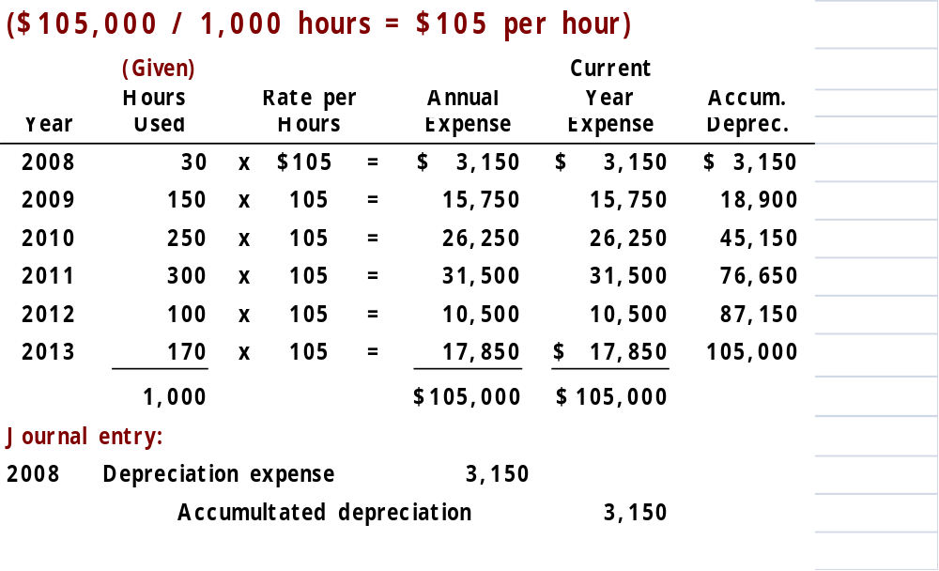
Depreciation for Partial Year
Exercise (Units-of-Activity Method)
LO 3 Compute periodic depreciation using different methods.

Slide 27
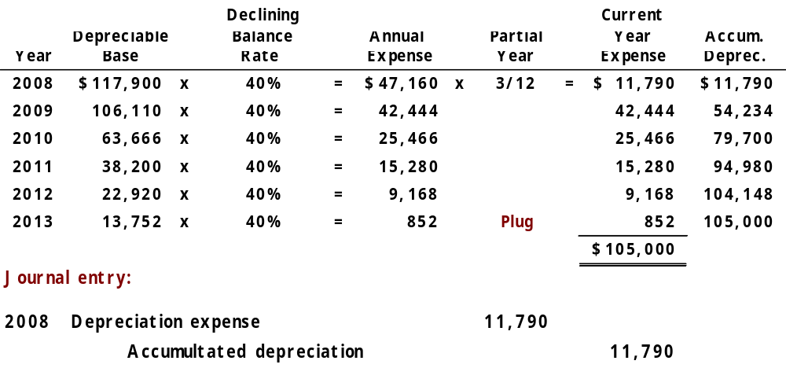
Depreciation for Partial Year
Exercise (Declining-Balance Method)
LO 3 Compute periodic depreciation using different methods.

Slide 28
Depreciation
Depreciation and Income Taxes
IRS does not require taxpayer to use the same depreciation method on the tax return that is used in preparing financial statements.
IRS requires the Modified Accelerated Cost Recovery System, which is NOT acceptable under GAAP.
LO 3 Compute periodic depreciation using different methods.

Slide 29
Depreciation
Revising Periodic Depreciation
  Accounted for in the period of change and future periods (Change in Estimate).
  Not handled retrospectively.
  Not considered error.
LO 4 Describe the procedure for revising periodic depreciation.

Slide 30
Depreciation
Arcadia HS purchased equipment for $510,000 which was estimated to have a useful life of 10 years with a salvage value of $10,000 at the end of that time. Depreciation has been recorded for 7 years on a straight-line basis. In 2008 (year 8), it is determined that the total estimated life should be 15 years with a salvage value of $5,000 at the end of that time.
Questions:
  What is the journal entry to correct the prior years’ depreciation?
  Calculate the depreciation expense for 2008.
No Entry
Required
LO 4 Describe the procedure for revising periodic depreciation.

Slide 31
Depreciation
After 7 years
Equipment cost $510,000
Salvage value - 10,000
Depreciable cost $500,000
Useful life (original) / 10 years
Annual depreciation $ 50,000
First, establish BV at date of change in estimate.
x 7 years = $350,000
Balance Sheet (Dec. 31, 2007)
Fixed Assets:
Equipment
$510,000
Accumulated depreciation
- 350,000
Book value (BV)
$160,000
LO 4 Describe the procedure for revising periodic depreciation.

Slide 32
Depreciation
After 7 years
Book value $160,000
Salvage value (new) - 5,000
Depreciable cost $155,000
Useful life remaining / 8 years
Annual depreciation $ 19,375
Depreciation Expense calculation for 2008.
Journal entry for 2008
Depreciation expense 19,375
Accumulated depreciation 19,375
LO 4 Describe the procedure for revising periodic depreciation.

Slide 33
Expenditures During Useful Life
Ordinary Repairs - expenditures to maintain the operating efficiency and productive life of the unit.
  Debit - Repair (or Maintenance) Expense.
  Referred to as revenue expenditures.
Additions and Improvements - costs incurred to increase the operating efficiency, productive capacity, or useful life of a plant asset.
  Debit - the plant asset affected.
  Referred to as capital expenditures.
LO 5 Distinguish between revenue and capital expenditures, and explain the entries for each.

Slide 34
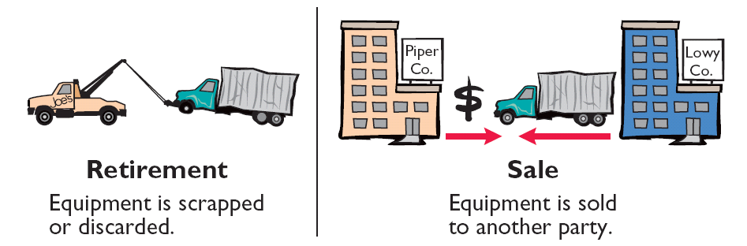
Plant Asset Disposals
Companies dispose of plant assets in three ways —Retirement, Sale, or Exchange (appendix).
Illustration 10-18
Record depreciation up to the date of disposal.
Eliminate asset by (1) debiting Accumulated Depreciation, and (2) crediting the asset account.
LO 6 Explain how to account for the disposal of a plant asset.

Slide 35
Plant Asset Disposals - Retirement
BE10-9 Prepare journal entries to record the following.
(a) Gomez Company retires its delivery equipment, which cost $41,000. Accumulated depreciation is also $41,000 on this delivery equipment. No salvage value is received.
(b) Assume the same information as (a), except that accumulated depreciation for Gomez Company is $39,000, instead of $41,000.
(a)
Accumulated depreciation 41,000
Equipment 41,000
LO 6 Explain how to account for the disposal of a plant asset.

Slide 36
Plant Asset Disposals - Retirement
BE10-9 Prepare journal entries to record the following.
(a) Gomez Company retires its delivery equipment, which cost $41,000. Accumulated depreciation is also $41,000 on this delivery equipment. No salvage value is received.
(b) Assume the same information as (a), except that accumulated depreciation for Gomez Company is $39,000, instead of $41,000.
(b)
Accumulated depreciation 39,000
Loss on disposal 2,000
Equipment 41,000
LO 6 Explain how to account for the disposal of a plant asset.

Slide 37
Plant Asset Disposals
Sale of Plant Assets
  Compare the book value of the asset with the proceeds received from the sale.
    If proceeds exceed the book value, a gain on disposal occurs.
    If proceeds are less than the book value, a loss on disposal occurs.
LO 6 Explain how to account for the disposal of a plant asset.

Slide 38
Plant Asset Disposals - Sale
BE10-10 Chan Company sells office equipment on September 30, 2008, for $20,000 cash. The office equipment originally cost $72,000 and as of January 1, 2008, had accumulated depreciation of $42,000. Depreciation for the first 9 months of 2008 is $5,250. Prepare the journal entries to (a) update depreciation to September 30, 2008, and (b) record the sale of the equipment.
LO 6 Explain how to account for the disposal of a plant asset.

Slide 39
Plant Asset Disposals - Sale
BE10-10 Prepare the journal entries to (a) update depreciation to September 30, 2008, and (b) record the sale of the equipment.
(a)
Depreciation expense 5,250
Accumulated depreciation 5,250
(b)
Cash 20,000
Accumulated depreciation 47,250
Loss on disposal 4,750
Office equipment 72,000
LO 6 Explain how to account for the disposal of a plant asset.

Slide 40
Section 2 – Natural Resources
Natural resources consist of standing timber and underground deposits of oil, gas, and minerals.
Distinguishing characteristics:
Physically extracted in operations.
Replaceable only by an act of nature.

Slide 41
Section 2 – Natural Resources
Cost - price needed to acquire the resource and prepare it for its intended use.
Depletion - allocation of the cost to expense in a rational and systematic manner over the resource’s useful life.
Depletion is to natural resources as depreciation is to plant assets.
Companies generally use units-of-activity method.
Depletion generally is a function of the units extracted.
LO 7 Compute periodic depletion of natural resources.

Slide 42
Section 2 – Natural Resources
BE10-11 Olpe Mining Co. purchased for $7 million a mine that is estimated to have 35 million tons of ore and no salvage value. In the first year, 6 million tons of ore are extracted and sold. (a) Prepare the journal entry to record depletion expense for the first year. (b) Show how this mine is reported on the balance sheet at the end of the first year.
Depletion cost per unit = $7,000,000 ÷ 35,000,000 = $.20 depletion cost per ton
$.20 X 6,000,000 = $1,200,000
LO 7 Compute periodic depletion of natural resources.

Slide 43
Section 2 – Natural Resources
BE10-11 (a) Prepare the journal entry to record depletion expense for the first year. (b) Show how this mine is reported on the balance sheet at the end of the first year.
(a)
Depletion expense 1,200,000
Accumulated depletion 1,200,000
(b)
Balance Sheet Presentation
Ore mine 7,000,000
Less: Accum. depletion 1,200,000 5,800,000
LO 7 Compute periodic depletion of natural resources.

Slide 44

Section 3 – Intangible Assets
Intangible assets are rights, privileges, and competitive advantages that do not possess physical substance.
Intangible assets are categorized as having either a limited life or an indefinite life.
Common types of intangibles:
Patents
Copyrights
Franchises or licenses
Trademarks or trade names
Goodwill
LO 8 Explain the basic issues related to accounting for intangible assets.

Slide 45
Accounting for Intangible Assets
Valuation
Purchased Intangibles:
Recorded at cost.
Includes all costs necessary to make the intangible asset ready for its intended use.
Internally Created Intangibles:
Generally expensed.
Only capitalize direct costs incurred in perfecting title to the intangible, such as legal costs.
LO 8 Explain the basic issues related to accounting for intangible assets.

Slide 46
Accounting for Intangible Assets
Amortization of Intangibles
Limited-Life Intangibles:
Amortize to expense.
Credit asset account or accumulated amortization.
Indefinite-Life Intangibles:
No foreseeable limit on time the asset is expected to provide cash flows.
No amortization.
LO 8 Explain the basic issues related to accounting for intangible assets.

Slide 47
Accounting for Intangible Assets
Patents
Exclusive right to manufacture, sell, or otherwise control an invention for a period of 20 years from the date of the grant.
Capitalize costs of purchasing a patent and amortize over its 20-year life or its useful life, whichever is shorter.
Expense any R&D costs in developing a patent.
Legal fees incurred successfully defending a patent are capitalized to Patent account.
LO 8 Explain the basic issues related to accounting for intangible assets.

Slide 48
Accounting for Intangible Assets
BE10-11 Galena Company purchases a patent for $120,000 on January 2, 2008. Its estimated useful life is 10 years. (a) Prepare the journal entry to record patent expense for the first year. (b) Show how this patent is reported on the balance sheet at the end of the first year.
(a)
Amortization expense 12,000
Patent 12,000
(b)
Balance Sheet Presentation
Intangible assets:
Patent 108,000
LO 8 Explain the basic issues related to accounting for intangible assets.

Slide 49
Accounting for Intangible Assets
Copyrights
Give the owner the exclusive right to reproduce and sell an artistic or published work.
  plays, literary works, musical works, pictures, photographs, and video and audiovisual material.
Copyright is granted for the life of the creator plus 70 years.
Capitalize acquisition costs.
Amortized to expense over useful life.
LO 8 Explain the basic issues related to accounting for intangible assets.

Slide 50
Accounting for Intangible Assets
Trademarks and Trade Names
Word, phrase, jingle, or symbol that identifies a particular enterprise or product.
  Wheaties, Game Boy, Frappuccino, Kleenex, Windows, Coca-Cola, and Jeep.
Trademark or trade name has legal protection for indefinite number of 10 year renewal periods.
Capitalize acquisition costs.
No amortization.
LO 8 Explain the basic issues related to accounting for intangible assets.

Slide 51
Accounting for Intangible Assets
Franchises and Licenses
Contractual arrangement between a franchisor and a franchisee.
  Shell, Taco Bell, or Rent-A-Wreck are franchises.
Franchise (or license) with a limited life should be amortized to expense over the life of the franchise.
Franchise with an indefinite life should be carried at cost and not amortized.
LO 8 Explain the basic issues related to accounting for intangible assets.

Slide 52
Accounting for Intangible Assets
Goodwill
Includes exceptional management, desirable location, good customer relations, skilled employees, high-quality products, etc.
Only recorded when an entire business is purchased.
Goodwill is recorded as the excess of ...
purchase price over the FMV of the identifiable net assets acquired.
Internally created goodwill should not be capitalized.
LO 8 Explain the basic issues related to accounting for intangible assets.

Slide 53
Research and Development Costs
Frequently results in something that a company patents or copyrights such as:
new product,
process,
idea,
formula,
composition, or
literary work.
All R & D costs are expensed when incurred.
LO 8 Explain the basic issues related to accounting for intangible assets.

Slide 54
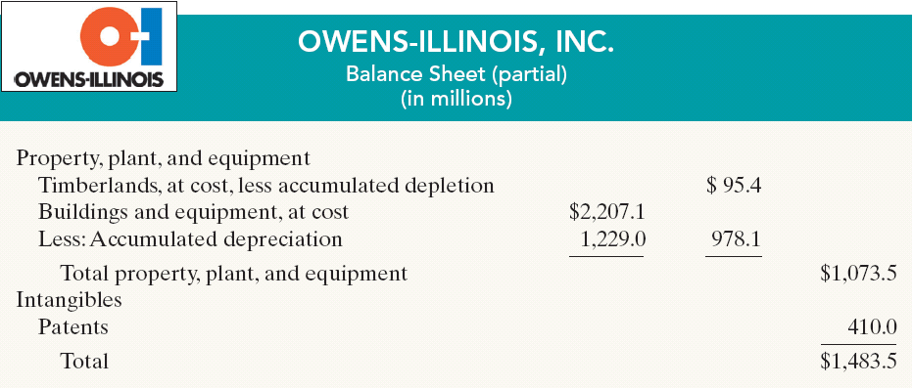
Statement Presentation and Analysis
Presentation
Illustration 10-24
Companies usually include natural resources under “Property, plant, and equipment” and show intangibles separately.
LO 9 Indicate how plant assets, natural resources, and intangible assets are reported.

Slide 55
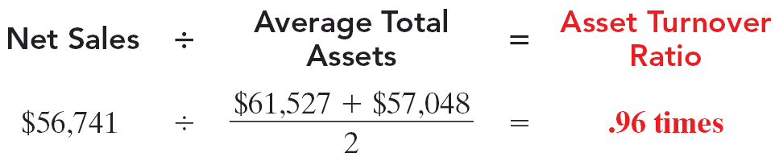
Statement Presentation and Analysis
Analysis
Illustration 10-25
Each dollar invested in assets produced $0.96 in sales. If a company is using its assets efficiently, each dollar of assets will create a high amount of sales.
LO 9 Indicate how plant assets, natural resources, and intangible assets are reported.

Slide 56
Exchange of Plant Assets
Ordinarily, companies record a gain or loss on the exchange of plant assets.
The rationale for recognizing a gain or loss is that most exchanges have commercial substance.
An exchange has commercial substance if the future cash flows change as a result of the exchange.
LO 10 Explain how to account for the exchange of plant assets.

Slide 57
Exchange of Plant Assets – Loss Treatment
Assume Roland Company exchanged a set of used trucks plus cash for a new semi-truck. The used trucks have a combined book value of $42,000 (cost of $64,000 and accumulated depreciation of $22,000). The used trucks have a fair market value of $26,000. Roland must pay $17,000 for the semi-truck.
Compute the loss on the exchange.
Book value of used trucks $42,000
Fair market value of used trucks 26,000
Loss on exchange $16,000
LO 10 Explain how to account for the exchange of plant assets.

Slide 58
Exchange of Plant Assets – Loss Treatment
Assume Roland Company exchanged a set of used trucks plus cash for a new semi-truck. The used trucks have a combined book value of $42,000 (cost of $64,000 and accumulated depreciation of $22,000). The used trucks have a fair market value of $26,000. Roland must pay $17,000 for the semi-truck.
Prepare the journal entry to record the exchange.
Semi truck 43,000
Accumulated depreciation 22,000
Loss on disposal 16,000 Used trucks 64,000
Cash 17,000
LO 10 Explain how to account for the exchange of plant assets.

Slide 59
Exchange of Plant Assets – Gain Treatment
Assume Mark Express Delivery decides to exchange its old delivery equipment plus cash of $3,000 for new delivery equipment. The book value of the old delivery equipment is $12,000 (cost $40,000 less accumulated depreciation of $28,000), and the fair market value of the old equipment is $19,000.
Compute the gain on the exchange.
Fair market value of old equipment $19,000
Book value of old equipment 12,000
Gain on exchange $ 7,000
LO 10 Explain how to account for the exchange of plant assets.

Slide 60
Exchange of Plant Assets – Gain Treatment
Assume Mark Express Delivery decides to exchange its old delivery equipment plus cash of $3,000 for new delivery equipment. The book value of the old delivery equipment is $12,000 (cost $40,000 less accumulated depreciation of $28,000), and the fair market value of the old equipment is $19,000.
Prepare the journal entry to record the exchange.
Delivery equipment 22,000
Accumulated depreciation 28,000
Delivery equipment 40,000 Gain on disposal 7,000
Cash 3,000
LO 10 Explain how to account for the exchange of plant assets.

Slide 61
Copyright
“Copyright © 2008 John Wiley & Sons, Inc. All rights reserved. Reproduction or translation of this work beyond that permitted in Section 117 of the 1976 United States Copyright Act without the express written permission of the copyright owner is unlawful. Request for further information should be addressed to the Permissions Department, John Wiley & Sons, Inc. The purchaser may make back-up copies for his/her own use only and not for distribution or resale. The Publisher assumes no responsibility for errors, omissions, or damages, caused by the use of these programs or from the use of the information contained herein.”

